Slide 1



Update on RIEDP
Reuse and Interoperation
of Environmental Data & Processes
to ISO/IEC SC 24/WG 8
23 August 2016
Jean-Louis GOUGEAT
Chair - RIEDP Product Development Group

Slide 2
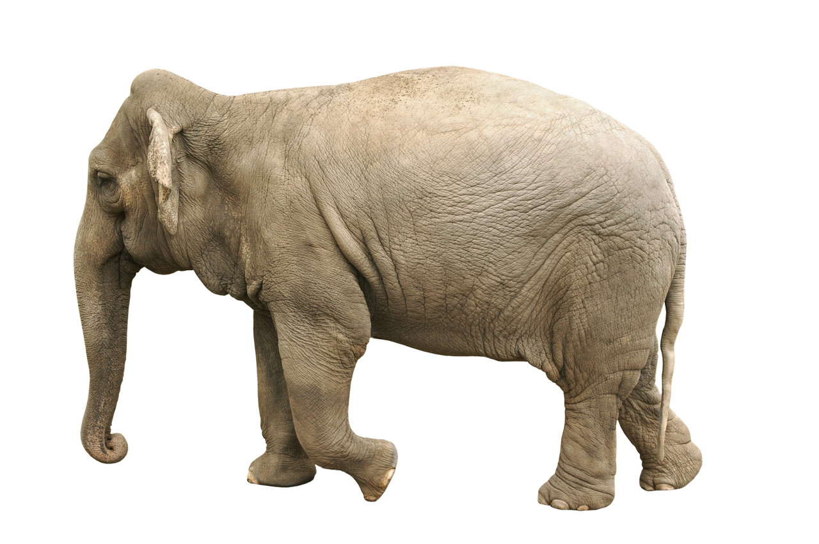
“The Elephant observed by the Blinds”
“ If you are holding a hammer, everything looks like a nail! ”
1
Notes:
Planche 1 : Background - « The Elephant observed by the Blind»
I will use two allegories in my presentation : one at the beginning, one at the end
The first one is based on the anonymous fable of the Elephant observed by the Blind :
It means that facing a huge problem, everybody believes that what they see is the whole picture.
Not to many elephants in France, as you might know, and we also say “All the hammers see their problem in the form of a nail … » Click

Slide 3
Agenda
  Introduction
  Background
    Environment Requirements in Distributed Simulation
    Interoperability and Standards
    Database Creation Process
  RIEDP PDG
    Scope
    Status
    RIEDP & SEDRIS
  Conclusion
RIEDP: Reuse and Interoperation of Environmental Data & Processes
PDG: Product Development Group (SISO Group in charge)

Slide 4
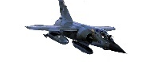
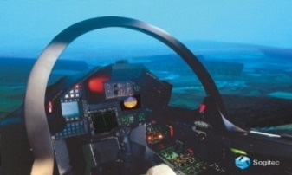
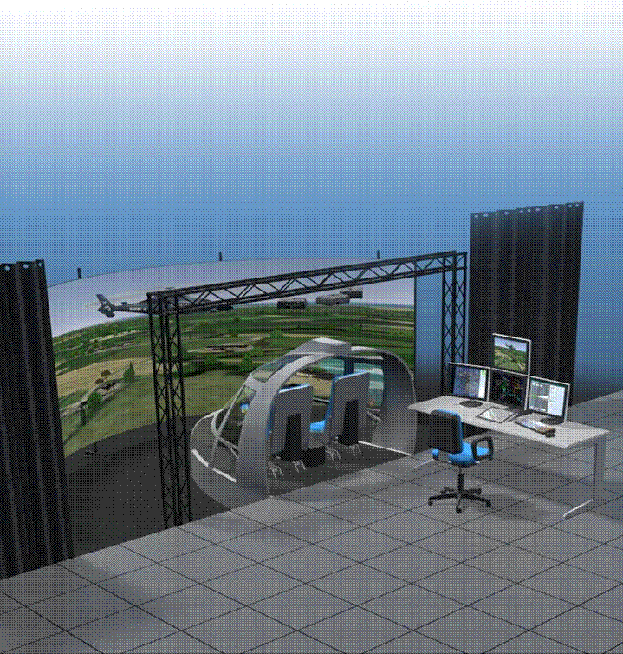
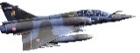



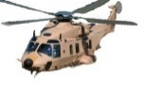
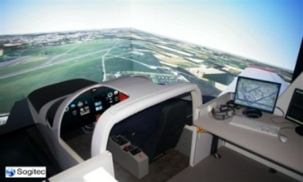
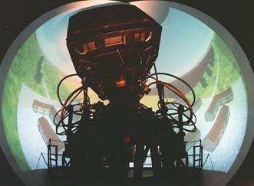

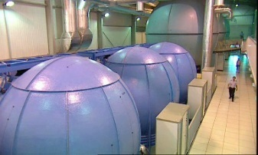
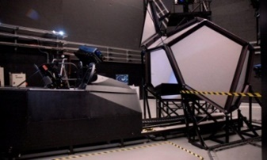
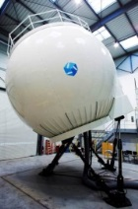
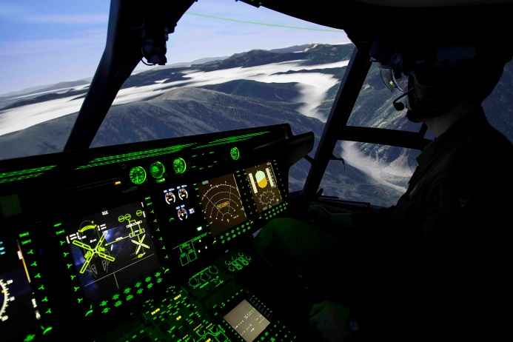
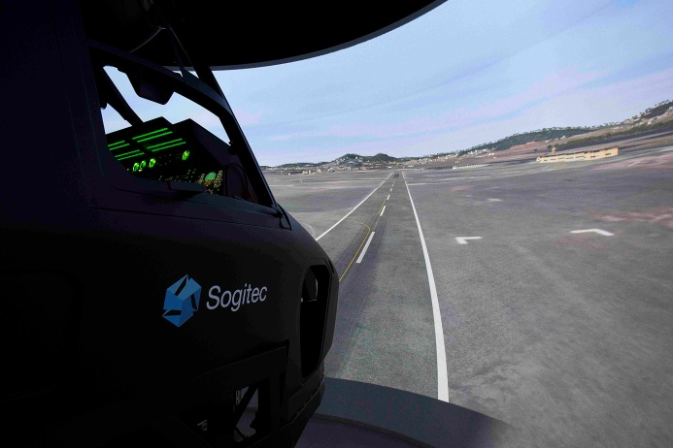
Sogitec at a glance
Simulators for Training
  Mirage Family (F1, -5, D, -9, H, …)
  Rafale Omnirole A/C
  Helico (NH90, Dauphin, Cougar)
Users
  France
    FAF, Army Light Aviation, Navy
  Foreign users
    NATO
    Middle East (Egypt, Qatar, UAE, …)
    Taiwan
    India
    …

Slide 5
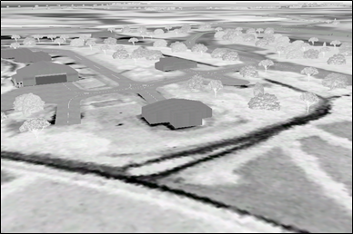
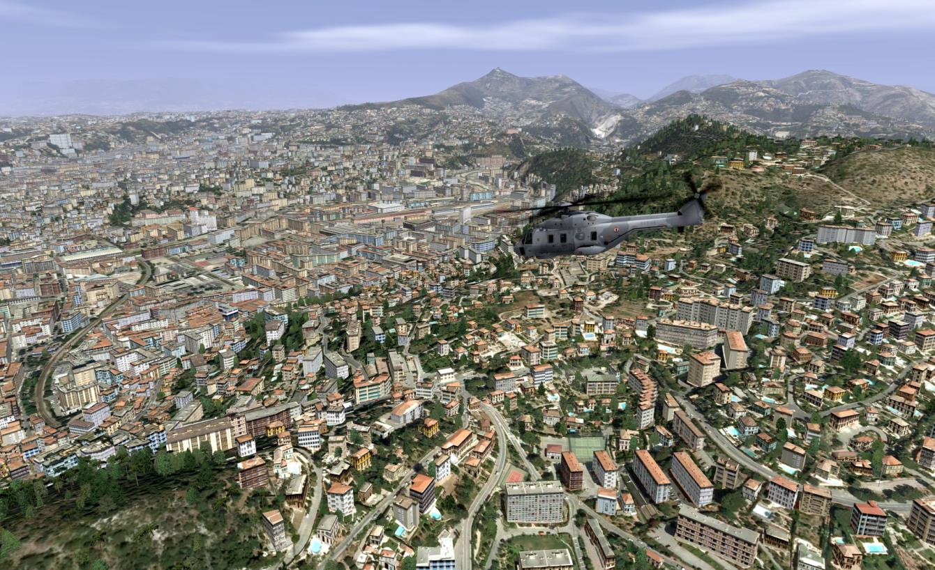
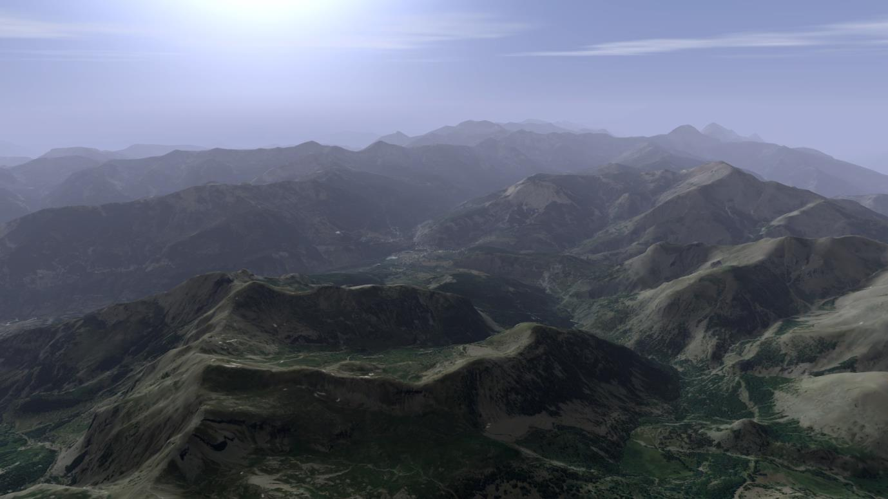
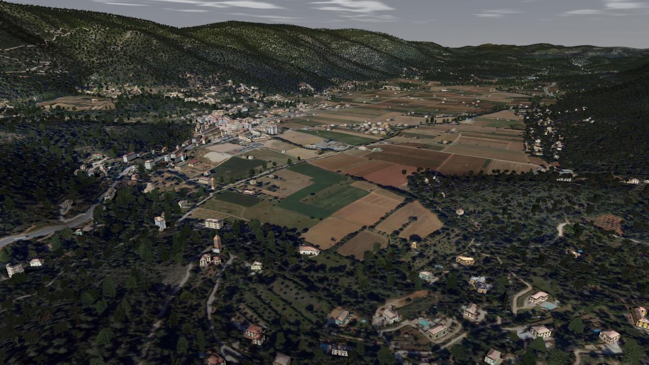
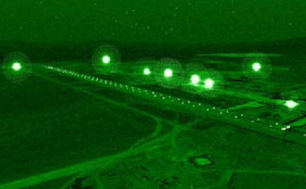
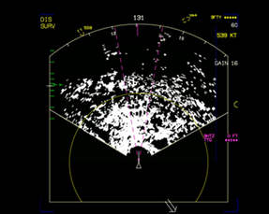
Environment Requirements for an Aircraft Simulator
Diversity of Terrain natures
Diversity of Target
Applications
(Visual, Sensors, IOS, CGF, …)

Slide 6
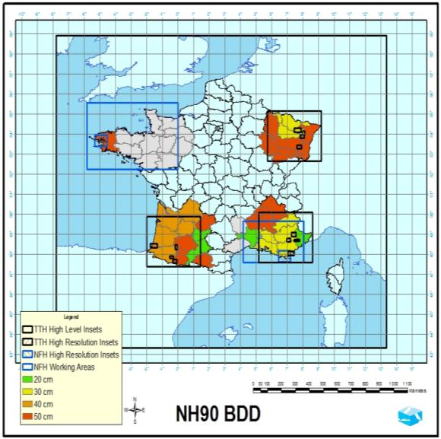
Typical Terrain Requirements (e.g. France NH90 FFS)
Large Database
  ½ Million km2 and more
Higher Fidelity
For Training &
Mission Rehearsal

Slide 7
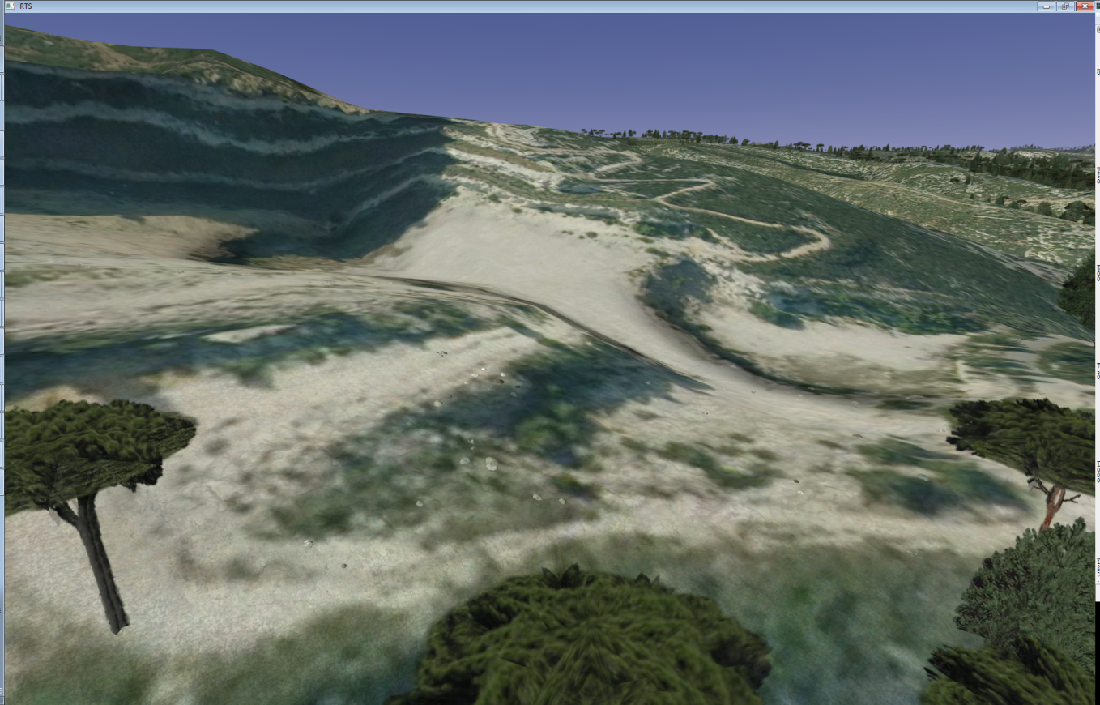
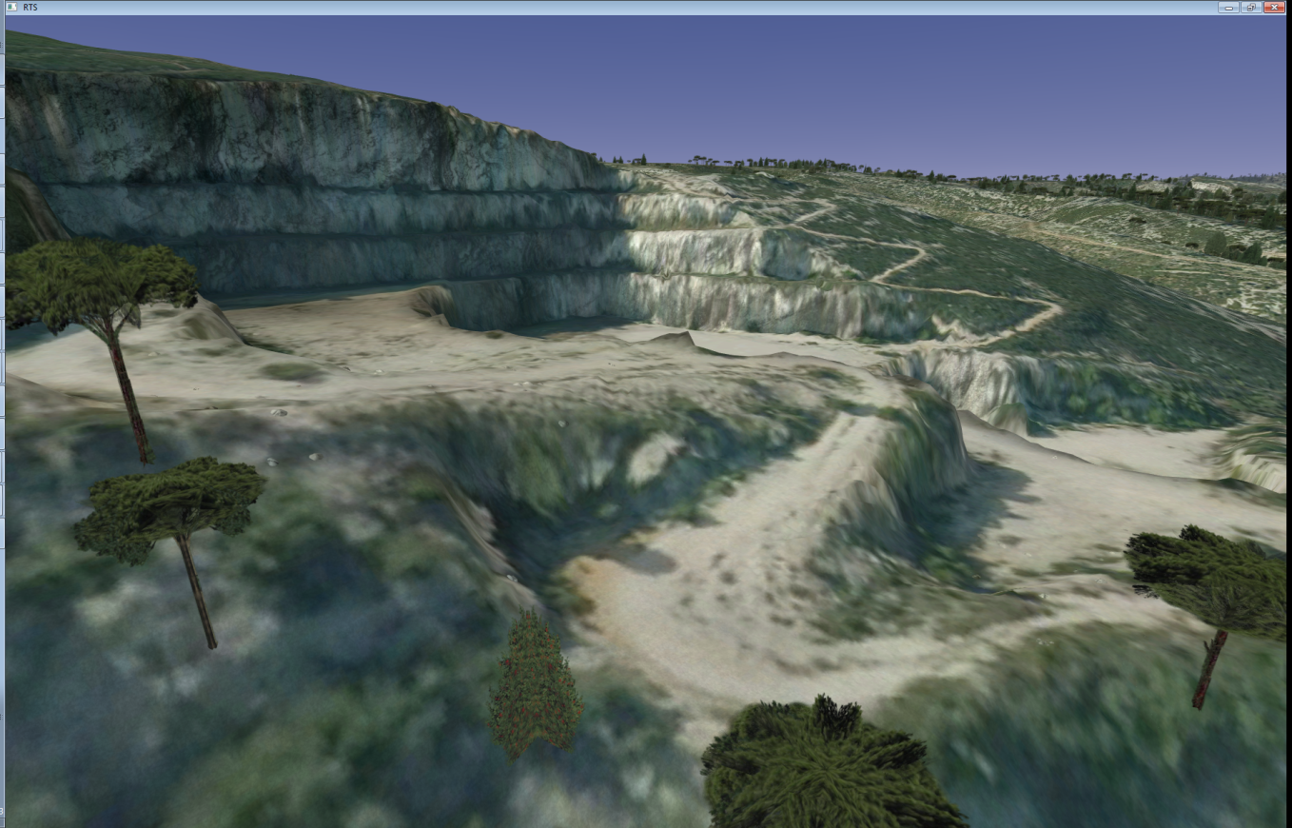
Towards more Fidelity in the Environment
  Elevation Grid: 25 m
  Elevation Grid: 1 m
1- More fidelity is required
2- Not just Imagery

Slide 8



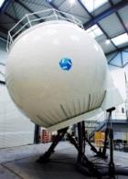
Building the Simulator Database
€ / $
Target
Databases
Database
Requirements
Visual DB
Source
Data
Radar DB
Database
Creation
IR DB
Other Sensors
CGF DB
Find the data
Solve IPR
Clean the data
Correlate the data
Create missing data
Format the data
Intensify the data
Specialize the data
Operate !
Maps
Not Easy
Others

Slide 9
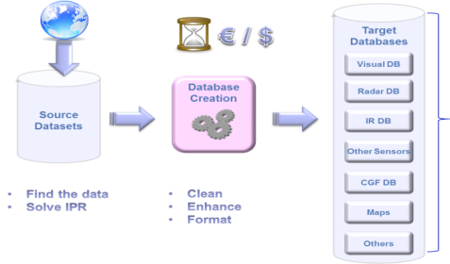





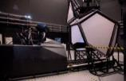




Main issues for Distributed Simulation
Reuse – Correlation – Interoperability ….
Sim A - Provider 1
Duplication of efforts
Duplication of Cost
Time to market
Consistency ?
Schedule ?
Sim B - Provider 2
Requirements
Sim C – Provider 3
M&S Interoperability is
even more critical in the International Arena
with
Multiple Providers and Multiple M&S Solutions

Slide 10
M&S Interoperability
What it is Not
  The same Product and associated Solutions for everyone
    Does not work, certainly not in the international arena
    Puts innovation at risk
    What product to choose? No single solution is sufficient
What it is
  Consistency in Modelling, associated Data and Semantics at Component Level
  Allowing Components to work together at System & System-of-Systems Levels
  Fostering Multiple-Provider Solutions (e.g. : I/ITSEC/OBW Federations)
Interoperability relies on Appropriate Standards

Slide 11
Appropriate Standards
What for?
  Interoperability …
  Avoiding “reinvention of the wheel” and …
  Focusing Fair Competition on other value-added Solutions
Conditions
  Truly Open Standard Development and Maintenance Process
For LVC M&S Community, this is the role of SISO
LVC: Live Virtual Constructive

Slide 12
Appropriate standards – Environmental Data: RIEDP
Use resources from existing Standards (SISO, ISO, NATO)
  Specification of Entity Identification (SISO SWG Enumerations)
  Specification of Position and Orientation Data (ISO/IEC SEDRIS/SRM)
  Identification of Objects / Features and their Attributes (ISO/IEC SEDRIS/EDCS)
  Definition of a Representation Model of the Environment (ISO/IEC SEDRIS/DRM)
  Specification of Metadata (ISO 19115, DCMI, DDMS, FGDC, EDS)
  Alliance M&S Standards Profile (NATO MSG)
Complement this Foundation for M&S applications (RIEDP Focus)
  Make use of “de-facto” standards from the Military and GIS communities
  Develop additional elements to address M&S-specific needs
RIEDP Initial Focus :
  Aircrew Training & Mission Rehearsal, extensible to the broader M&S COI
COI: Community of Interest
DCMI: Dublin Core Metadata Initiative
DDMS: DoD Discovery Metadata Specification
EDS: Enterprise Data Services
FGDC: Federal Geographic Data Committee
SWG: Special Working Group

Slide 13
Data Transformation Process – Two main phases
Target
Databases
GIS World
M&S World
Visual DB
Source
Data
Synthetic
Environment
Intermediate
Data
Database
Creation
Phase 1
Data
Cleaning &
Enhancement
Phase 2
Target
DBs
Generation
Radar DB
IR DB
Other Sensors
Standardize here
at appropriate Intermediate Level
CGF DB
Maps
Others
Manual Work: 80% 20%
Computation Time: 20% 80%

Slide 14
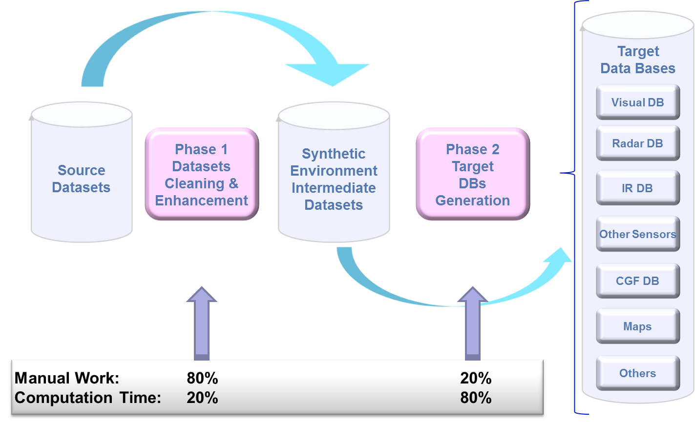
Data Transformation Process – Improvement through RIEDP
The process may be made more efficient
  If Source data is consistent
    Within each and between the layers (depends on Data providers)
  If previous creation efforts may be reused
    At Source Data Level (Linked to GIS World)
    At Intermediate Level
      Requires Common Processes, Representations, and Formats at this level
RIEDP
Reuse of Intensification efforts
Hardly
Reusable / Capitalisable
(Unless same target platforms)
Discovery & Access
Metadata
Data Quality
EDS

Slide 15
Overview of International Standardization Efforts
Nature | Standards |  | Projects |  |  |  |  |  | Other
Name | SIF | SEDRIS | NPSI | AFCD | CDB | SE Core | Missionland | Other | EDS
Origin | US DOD | US DOD | US Navy | USAF | USSOCOM | US Army | NATO | e.g. French Air Force | US DoD
Introduction Date | 1991 | 1994 | 2004 | 2006 | 2004 | 2008 | 2010 | 2006 | 201x
Standard | Yes | Yes ISO | User Standard | User Standard | User & Commercial Standard | User Standard | User Standard | User Standard | Reuse of Standards
Open Standard | Yes | Yes | limited | limited | Open Specification | limited | limited | limited | -
Approach | Format according to standard | Standardized Semantics and Data Model + Format according to standard |  |  |  |  |  |  | Data Discovery & Access
Availability of Commercial Support Tools | Obsolete | Tools developed in SEDRIS COI |  |  |  |  |  |  | Portal
Based on de-facto Standard Formats (GIS Source)
but
No Consistent Semantics or Data Model
Similar but not Standard Data Generation Process
RIEDP addresses these Topics
Commercial Tools
for Commercial & Standards Formats
AFCD: Air Force Common database
COI: Community of Interest
EDS: Enterprise Data Services
NPSI: NAVAIR Portable Source Initiative
SIF: SSDB (Standard Simulator Database) Interchange Format
SE Core: Synthetic Environment Core

Slide 16
Scope of the SISO RIEDP Product Development Group
Standardization efforts needed in following areas:
  A Reference Process Model
  An expressed Data Model for the specific applications
  Formats with specified use/parameters
  Standardized Attribution and Metadata
Divided along two axes leading to two products:
  RIEDP Data Model Foundations with two coupled parts:
    The Reference Process Model (RPM) - High Level representation of the database creation process model
    Reference Abstract Data Model (RADM) - High level Database concepts: Including principles of Tiles, Layers, Library, Spatial Reference, Relationships, …
  RIEDP Detailed Features description:
    Objects: Identification of geo-specific object instances and templates (features, 3D objects, textures) within the Library, and the linkage between instances and templates;
    Dictionary: choice of semantics and mapping with existing dictionaries;
    Attribution: Identification of a common list of features, attributes, attribution rules, range values ...

Slide 17
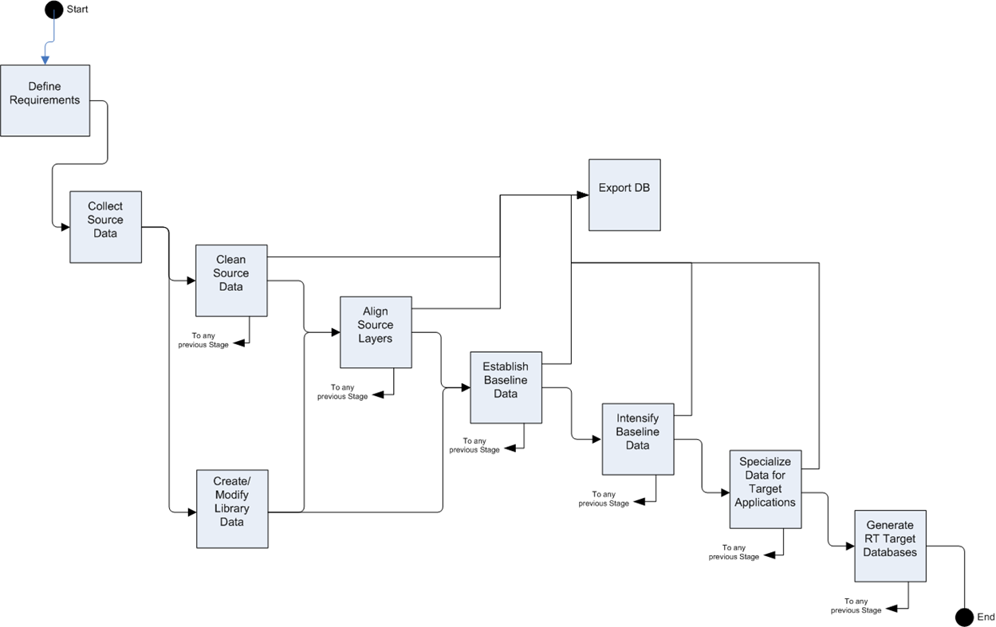
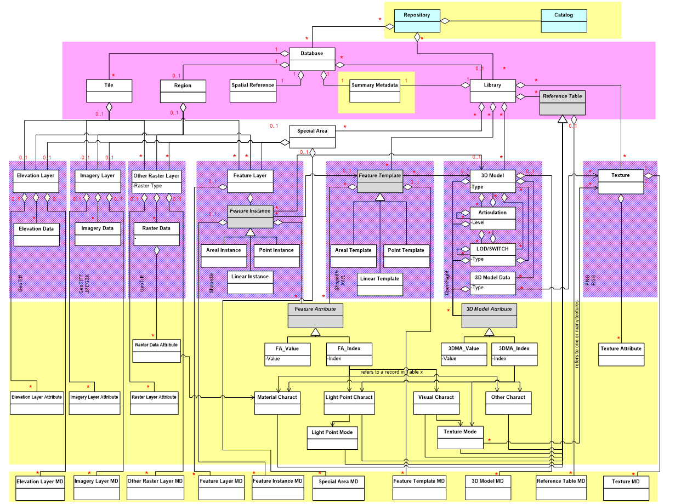
Status of RIEDP Products at mid 2016
Product n°1
  New version of the RIEDP Data Model Foundations
    Updated RPM and RADM
    Completion of the document
      incl. Organization of data on media, Profiles, Conformance
    Informal Review in progress
    SISO Formal Review expected in Fall ‘16
Product n°2
  Initiation of the RIEDP Detailed Features Description
  Fall ‘16 SIW
RIEDP DM Foundations
V 1,0

Slide 18

Latest Draft of the RIEDP Reference Process Model
Process Flow

Slide 19
Enhanced Intermediate Level -
Sharing data with the highest possible added value
Enhanced
“Intermediate Level”
“Intermediate Level”
Out of scope
AFCD/NPSI Requirements area
French Airforce Requirements area
SE CORE Requirements

Slide 20
Latest Draft of the RIEDP Reference Process Model
Data Flow

Slide 21
RIEDP Reference Abstract Data Model
Variability
Common format
Convergence
High Level Concepts of a Database
Showing areas of convergence and variability
Tiles, Layers Library,
COTS
Notes:
The upper part of the RADM (highlighted in solid purple) means that all initiatives may share (even though the RADM may not cover all cases) a similar view of the high level concepts of a database at the integrated level:
The DB is composed of geo-referenced tiles containing a set of layers: elevation, features, object, texture …
Feature instances of the real world are attached to tiles, and their rendering characteristics (visual, behavior …) are provided by the objects (and their attributes) from the library to which they are linked.
The middle part of the RADM (highlighted in dashed purple) may also be shared by all initiatives, as it is supported by their use of common GIS formats:
DTED, GeoTIFF, … for elevation;
Shapefiles for features;
OpenFlight for 3D objects;
JPEG2K, GeoTIFF, … for textures.
The lower part of the RADM (highlighted in yellow) corresponds to the attribution aspect of Shapefiles which is not constrained by the format. As a consequence, this is an area of divergence between initiatives.
Miscellaneous: other possible areas of divergence have been identified (yellow areas):
The Special areas, including for example airports and urban areas, that may be described either as features not related to tiles, or as OpenFlight objects;
The linkage between the objects of the Library and the Features;
Metadata associated to the database, which eventually feeds the catalog associated to the repository.

Slide 22
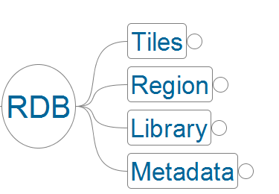
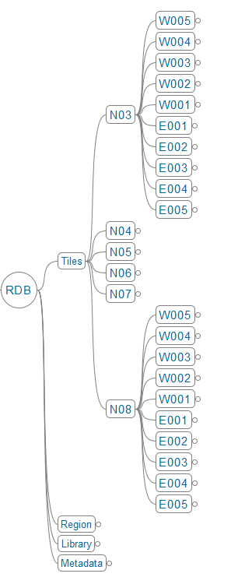
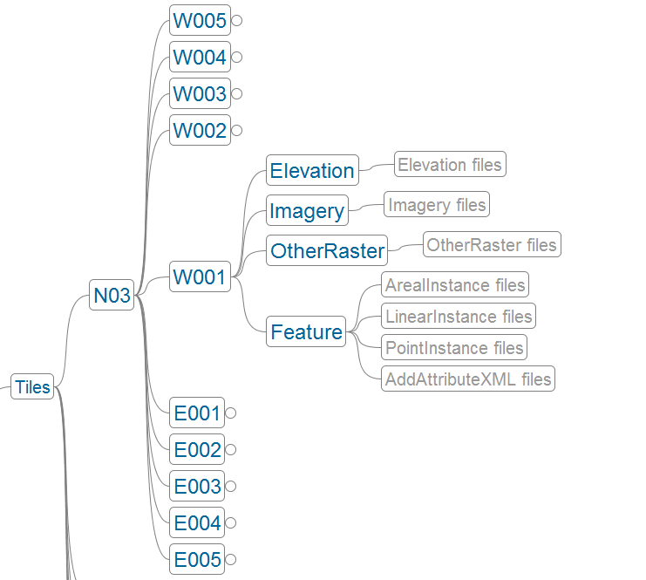
RIEDP Data Organization (extracted example)
Conceptual Data Organization
Data Organization on Media
RDB: RIEDP Database

Slide 23
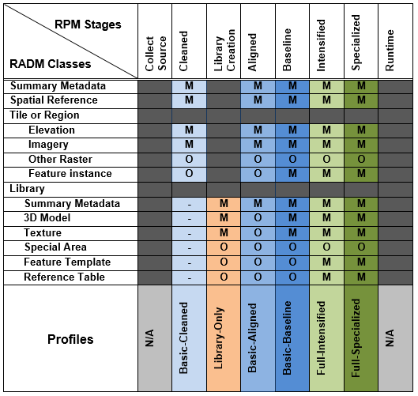
RIEDP Profiles
  RIEDP-compliant Data Products shall conform to one of the RIEDP Profiles
  A Profile specifies:
    A stage in the RPM
    Mandatory and Optional Data
    in accordance with the RADM

Slide 24
RIEDP and SEDRIS
Commonalities
    Exchange of Environmental Data
    Open Standard …
Differences
    SEDRIS is designed to address all types of environmental data
    RIEDP focuses on a subset and application-specific data
    SEDRIS is not designed to describe the database generation process
    RIEDP is designed to specifically address the database generation process
    SEDRIS defines a binary format (STF)
    RIEDP relies on existing GIS formats
    SEDRIS provides APIs and Tools
    Use of RIEDP relies on existing COTS Software & Tools
Complementarities
    RIEDP uses SEDRIS concepts, capabilities, and standards:
      RIEDP Abstract DM → Influenced by & with similarities to SEDRIS DRM
      Reference Frame → SRM is used for position and orientation
      Attribution → EDCS will be used (candidate) (Product # 2)
RIEDP and SEDRIS are complementary Efforts
  To be maintained jointly by the SISO/EDRS Product Support Group

Slide 25

RIEDP PDG – Get Involved
Please Join SISO by becoming a SISO Member
    by attending the SIW Meetings
    by registering on the Web Site ($ 90)
Then share with the community
  PDG SISO Discussion - Register for Discussion:
    Logon to SISO Discussions and select
      SAC-PDG-RIEDP (Don’t forget to select SUBMIT !)
  PDG SISO Webpage - Complete Affiliation Form:
    Standards Activities > Development Groups >
      Reuse and Interoperation of Environmental Data and Processes (RIEDP) PDG
  PDG SISO Library File Folder – Access PDG Documents:
    SISO Digital Library > Development Groups > RIEDP PDG

Slide 26

Participants in the Product Development Effort
Formal members (current SISO membership)
And other participants
First Name | Last Name | Affiliation(s) | Email Address
Gilbert | Castaner | Sogitec Industries | gcastaner@sogitec.fr
Rob | Cox | PEO STRI | robert.m.co14.civ@mail.mil
Paul | Foley | Consultant | pjfoley2@verizon.net
Arno | Gerretsen | NLR | arno.gerretsen@nlr.nl
Jean-Louis | GOUGEAT | Sogitec Industries | jlgougeat@sogitec.fr
Patrice | LE LEYDOUR | THALES | patrice.leleydour@thalesgroup.com
Arjan | Lemmers | Netherlands Aerospace Centre NLR | Arjan.Lemmers@nlr.nl
Warren | Macchi | Abamis IT Solutions | wmacchi@abamis.com
Farid | Mamaghani | self; SEDRIS Organization; US Army | farid@halcyon.com
Lance | Marrou | SE Core CVEM | lance.r.marrou@leidos.com
Ronald | Moore | SE Core/Leidos | ronald.g.moore@leidos.com
William | Oates | USAF | william.oates@afams.af.mil
Andreas | Reif | German Armed Forces | Andreas1reif@bundeswehr.org
David | Ronnfeldt | Australian Defence Simulation and Training Centre | david.ronnfeldt2@defence.gov.au
Roy | Scrudder | ARL:UT, US Army | roy.scrudder@arlut.utexas.edu
Robert | Siegfried | aditerna GmbH | robert.siegfried@aditerna.de
Simon | Skinner | XPI Simulation Ltd; Thales UK | simon.skinner@xpisimulation.com

Slide 27

Conclusion
Thank you for your attention !
Any questions ?
Please Join !

